Slide 1
MagicLantern – MLV and CDNG Workflow

Slide 2
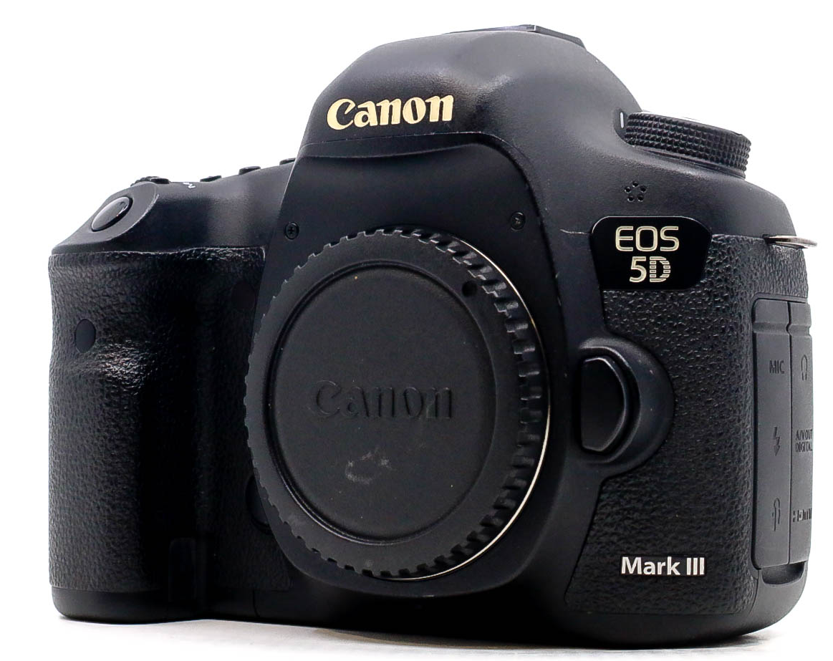


Must Do Photography
We want them to be processed, so we can work with normal .DNG files
Sometimes, not all files are saved in Dual ISO. You want to work with DNG+CR2/3 combined.

Slide 3
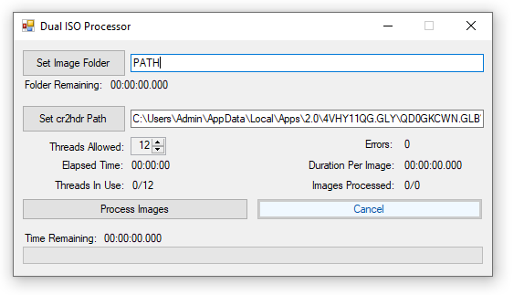
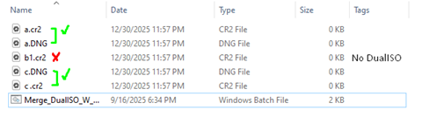
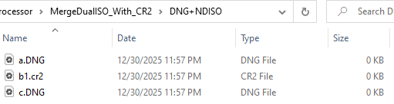
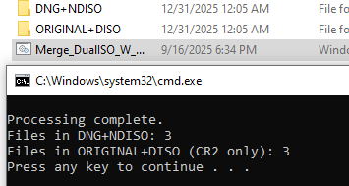
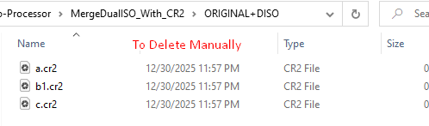
Must Do Photography
DNG+NDISO
.DNG Files with Not
Dual ISO Files
ORIGINAL+DISO
.CR2 Files W/o Dual ISO
and with Dual ISO

Slide 4


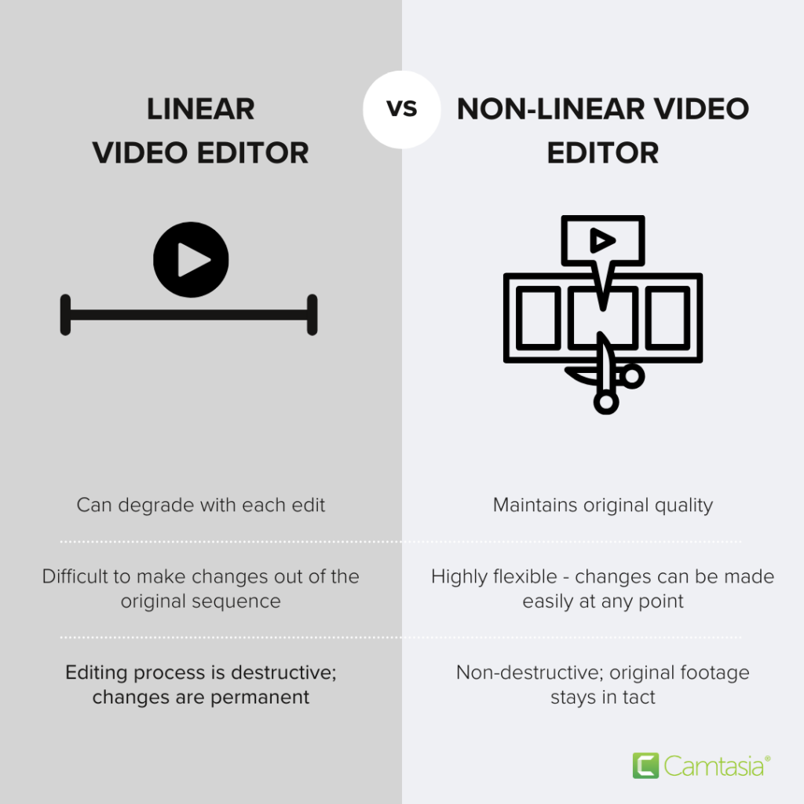
Must Do Film
NLE
H.264/H.265
Rec.709

Slide 5




Optional Photography
3rd party
We want them to be processed, so we can work with normal .DNG files
Usefull for multithreading when doing 3rd party processing.
Optional
DNG Compression. Need to implement.
Tools
Sometimes, not all files are saved in Dual ISO. You want to work with DNG+CR2/3 combined.
Create 0kb files. Useful to compare things or to do a call(tree).
Compare what’s unique between original and 0kb Files.

Slide 6
Optional Photography
3rd party
DNG+NDISO
.DNG Files with Not
Dual ISO Files
ORIGINAL+DISO
.CR2 Files W/o Dual ISO
and with Dual ISO

Slide 7


Optional Film
3rd party
We want them to be processed, so we can work with normal .DNG files
Usefull for multithreading when doing 3rd party processing.
Optional
DNG Compression. Need to implement.
If you work with DaVinci
DaVinci Workflow

Slide 8

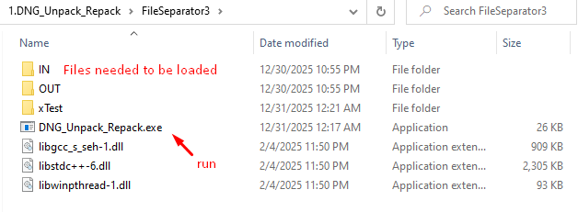
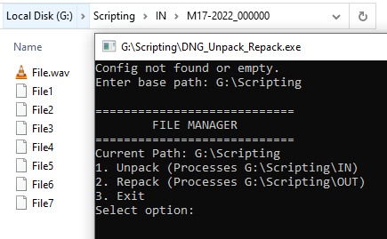
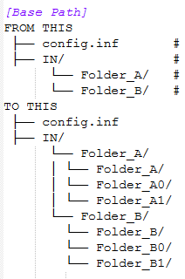
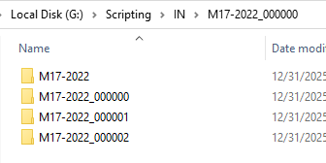
Optional Film
3rd party
unpack
repack
Repack is the reverse of the first one.
It repacks inside of \OUT.
1.

Slide 9
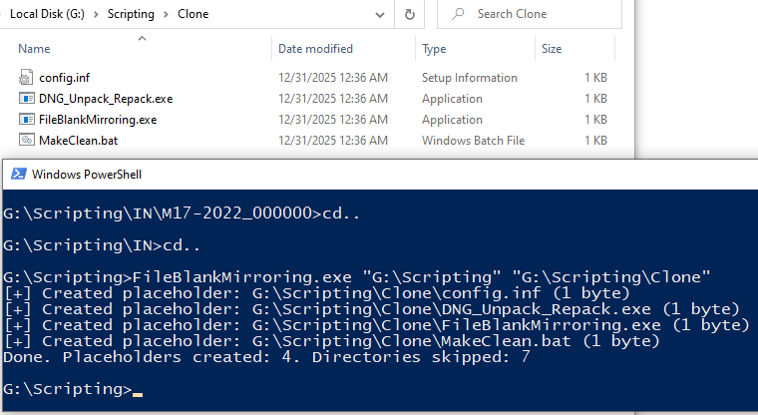
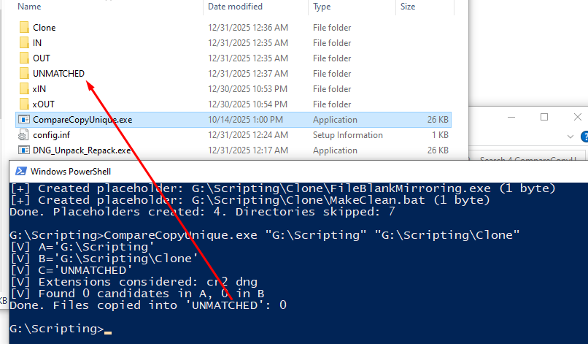
Optional Photography
Tools
Sometimes, not all files are saved in Dual ISO. You want to work with DNG+CR2/3 combined.
Create 0kb files. Useful to compare things or to do a call(tree).
Compare Real files with virtual ones
Compare what’s unique between original and 0kb Files.

Slide 10
Capable of 5.7K Anamorphic Output. MLV format 12~14 bit.
This translates to CinemaDNG.
With dual iso, 14 stops.

Slide 11
DNxHR
SlimRaw - Original
Keeping the Original
Pros:
Pros:
Pros:
Almost Raw quality.
10 Bit.
Interleaved – Faster decoding
Can be graded.
Best quality.
12-14 Bit.
True Raw
50% off size?
Could be even more?
Best quality.
True Raw.
14 Bit.
Cons:
Cons:
Cons:
Pain in the ass
Very huge files
Problems releated to playback
Pain in the ass
Very huge files
Problems releated to playback
Need to test.

Slide 12
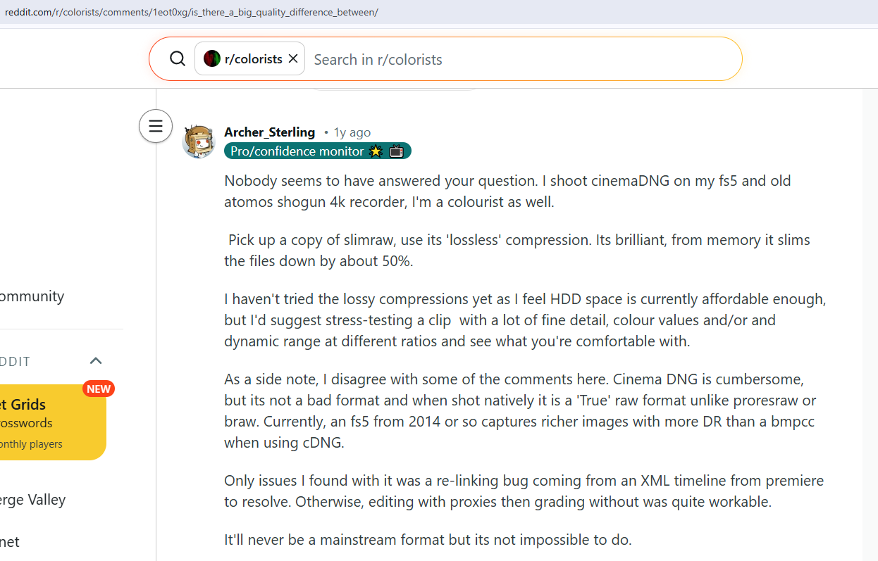

Slide 13
